Slide 1
Information security workshop
Firewall
Tzur eliyahu

Slide 2
Data leak prevention
Understanding DLP: downloaded Mailutils & Postfix, and followed the structure of SMTP packets.
Created an SMTP server and monitored the traffic between my host and the server to learn how to intercept and parse SMTP packets.

Slide 3
How to recognize C code?
A few discussions online, and these are some of my results:
Parentheses/brackets directly following text with no space to separate it: function()
An arrow between two words:= ptr->val – suggesting a pointer.
Presence of curly braces, brackets: while (true) { bar[i]; } - with threshold – meaning, after several sightings of brackets, we tag the payload as code and drop it.
Uncommon characters/operators(with a threshold of 2-3): &&,||, ==
Main function – looking for the structure ”int main(*){*}…”
If structure – “if (bool) { do }…”
while loop, for loop – “while (bool) {do}..”, “for(*;*;){do}”

Slide 4
Attack 1: Coppermine Photo Gallery 1.4.14
Coppermine is a multi-purpose fully-featured web picture gallery script written in PHP using GD or ImageMagick as image library with a MySQL backend.
It has a really convenient admin panel, and you can edit photos, crop them, play with angles, quality, etc…

Slide 5
Coppermine Photo Gallery 1.4.14 - Remote Command Execution Exploit
This attack occurs when two preconditions apply:
we use ImageMagick as the processing method. Meaning, every crop/angle/edit of the photo is being applied using this application. (/bin/convert)
The user used one of these 3 variables: “angle”, “quality” or “clipval”.

Slide 6
Coppermine Photo Gallery 1.4.14 - Remote Command Execution Exploit
﻿function rotateImage(&$angle){
{$CONFIG['im_options']} -rotate $angle $imgFile $imgFile";
exec ($cmd, $output, $retval);

Slide 7
Coppermine Photo Gallery 1.4.14 - Remote Command Execution Exploit
As we can see, "$angle" variable is used in command line string without being sanitized.
So, this attack can occur because of an un-sanitized variable.
The user uses one of the three mentioned above, and instead of “angle=20&quality=100…”, it can just send system commands (replacing the integeres with anything he wants), and they will get executed using the web server permissions.

Slide 8
Coppermine Photo Gallery 1.4.14 - Remote Command Execution Exploit
The fix: Make sure the variables are sanitized.
Each time a POST command goes out, The FW identifies the vulnerable variables, and makes sure that all they get are legal values and nothing more.

Slide 9
Attack 2: phpFileManager 0.9.8
A small application (single file) that acts as a filesystem management tool.
The developer of this application explained that he began developing it because he needed an easy way to access his webserver files from anywhere.

Slide 10
phpFileManager 0.9.8 Remote Code Execution
What the developer thought was an “easy” way to use commands, is actually an easy way to use system commands.
One of his features is actually called “execute command”:

Slide 11
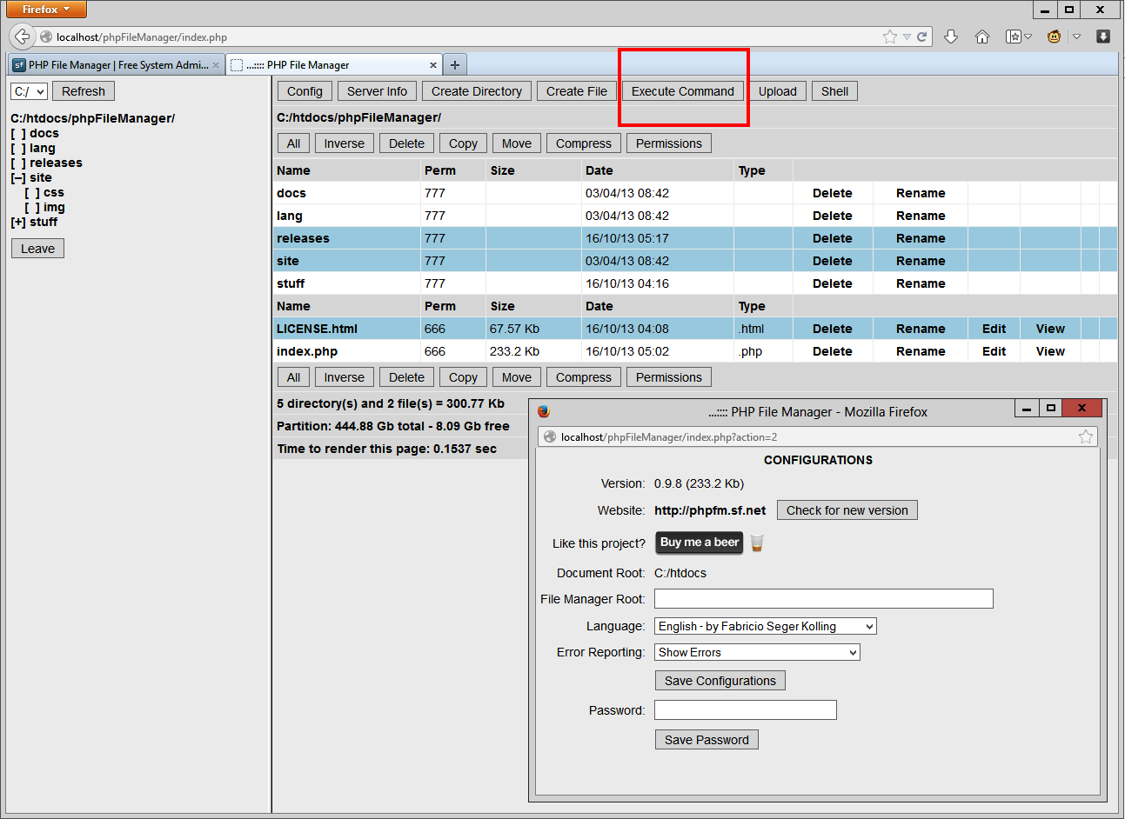

Slide 12
phpFileManager 0.9.8 Remote Code Execution
Yes, you can run any command using this tool. Just push it and write any system command you need. No user security or anything – you execute it with the /var/www pemissions.
There is an option for making it more secure - adding a password by going to the config window and defining one.
But that’s not the default way – the application is not secured at all, unless you choose to activate a little bit of security.

Slide 13
phpFileManager 0.9.8 Remote Code Execution
This feature carries too much risk, and even though the developer had good intentions and use for this feature, it is really easy to just use it to attack the machine, and this is a feature we’re better off without.
The only way of really protecting from this breach, is a complete block of this feature.

Slide 14
phpFileManager 0.9.8 Remote Code Execution
So, basically I just monitored every command to this application and completely blocked the commands that use this specific feature.
All of the other functionality works, except for this feature.

